Slide 1
Color Coding Schematics
Worksheet Assistance

Slide 2
Color Coding Schematics
Why we need to know this
  All car manufacturers use color coding on their wiring systems. German cars use red for battery +, black for ignition hot, brown for ground, ect…
  Japanese cars use white for battery + and black for ground. Wiring color varies from vehicle to vehicle, but good schematics should include codes for wiring color.

Slide 3
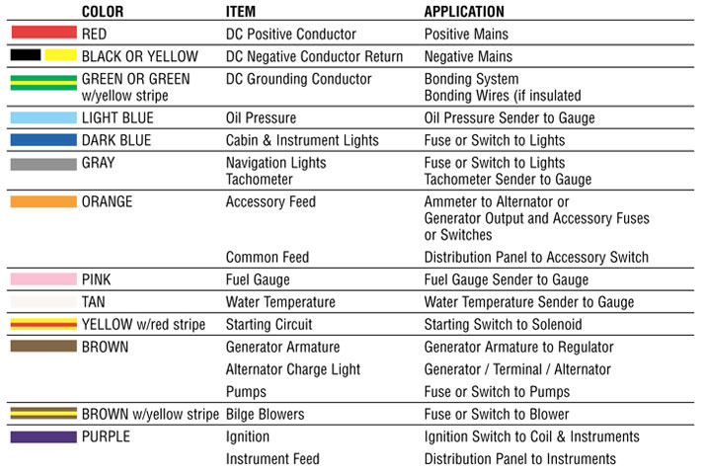
Sample Wiring Color Code Chart

Slide 4
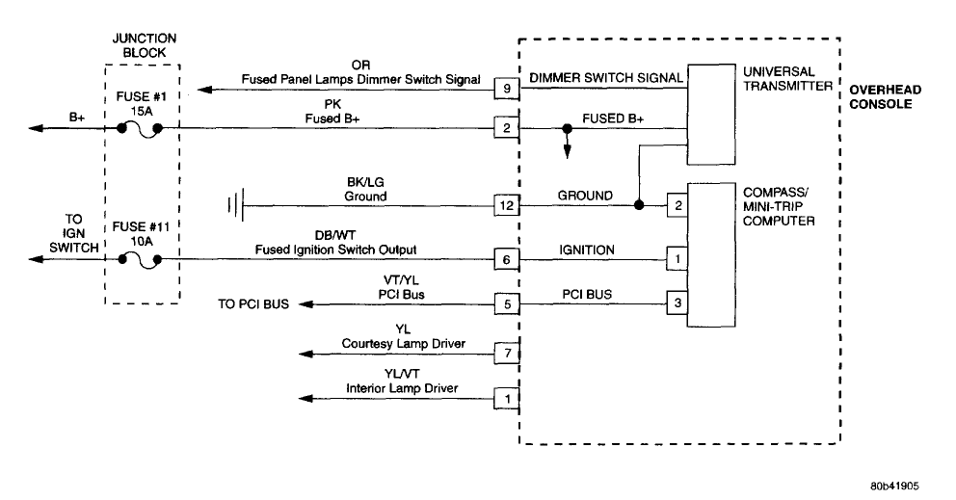
Now we are going to color some wiring schematics

Slide 5
First we will highlight the battery + circuit
We will use red or magenta

Slide 6
Next we will highlight the ground circuit
We will use green

Slide 7
Next we will highlight the switched power (+)
(Ignition hot) We will use orange

Slide 8
The rest of the wires will not be colored, Why?

Slide 9

Now see if you can color in
the next three diagrams

Slide 10
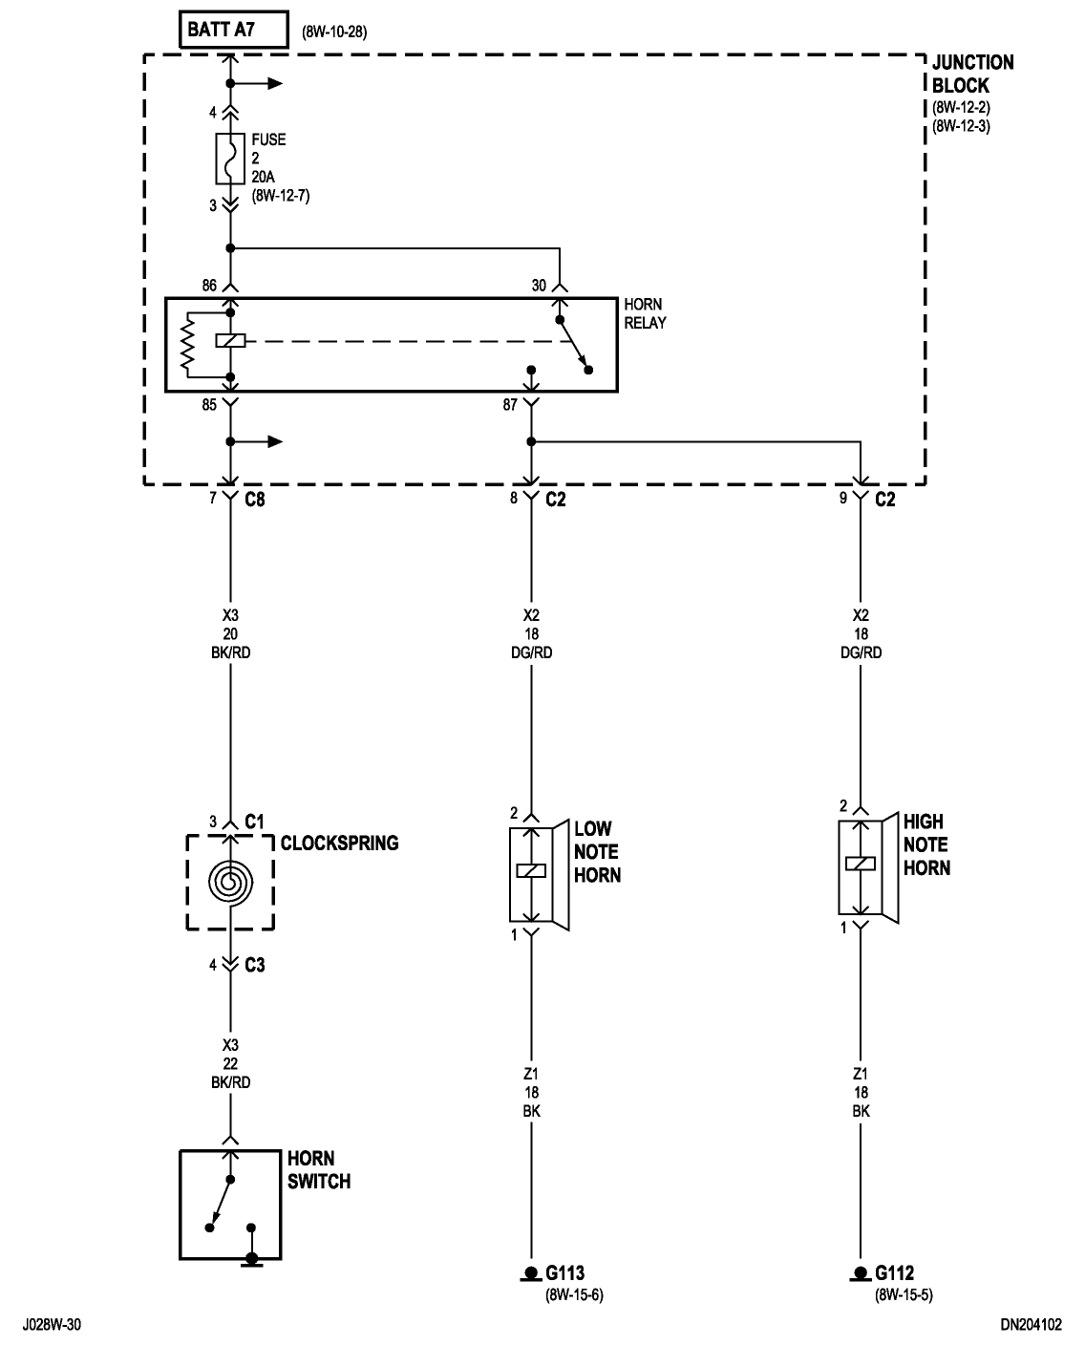

Slide 11
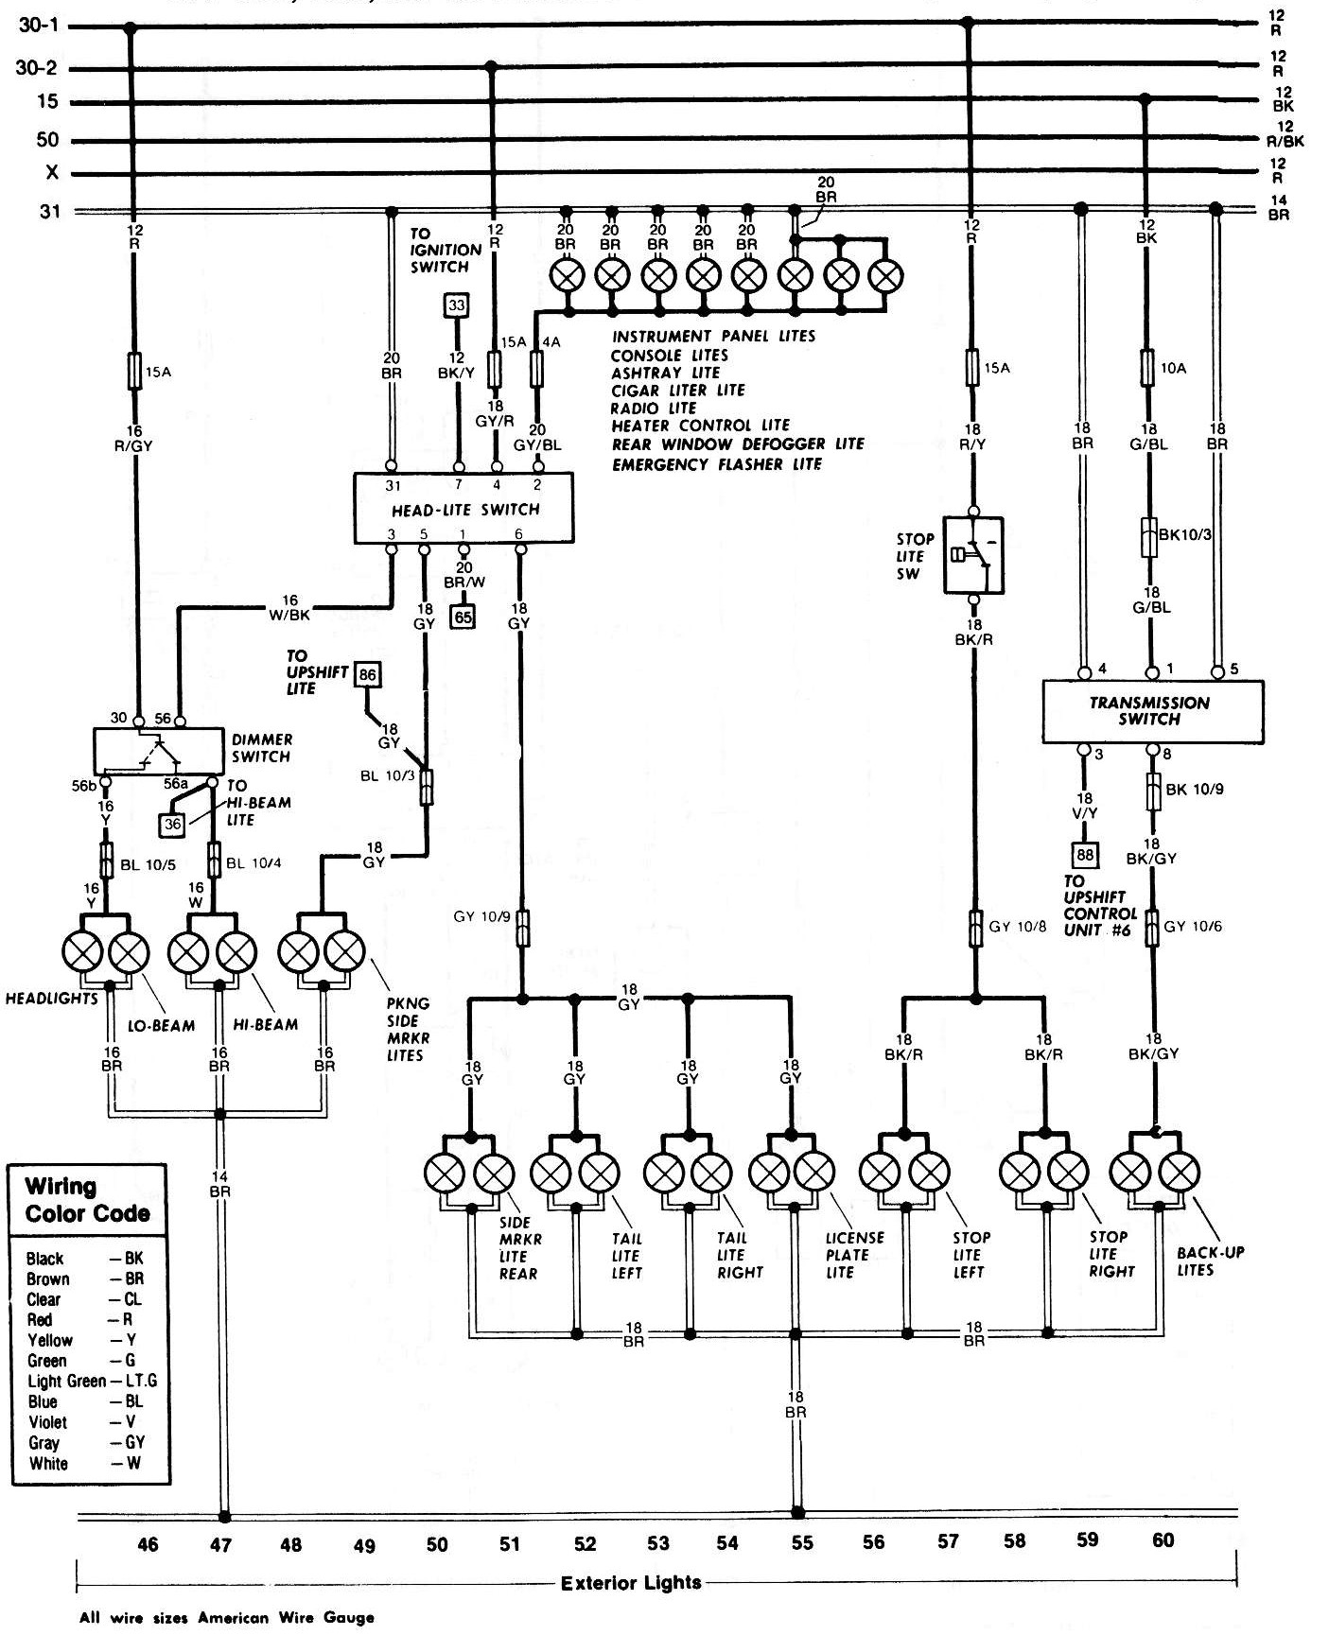

Slide 12
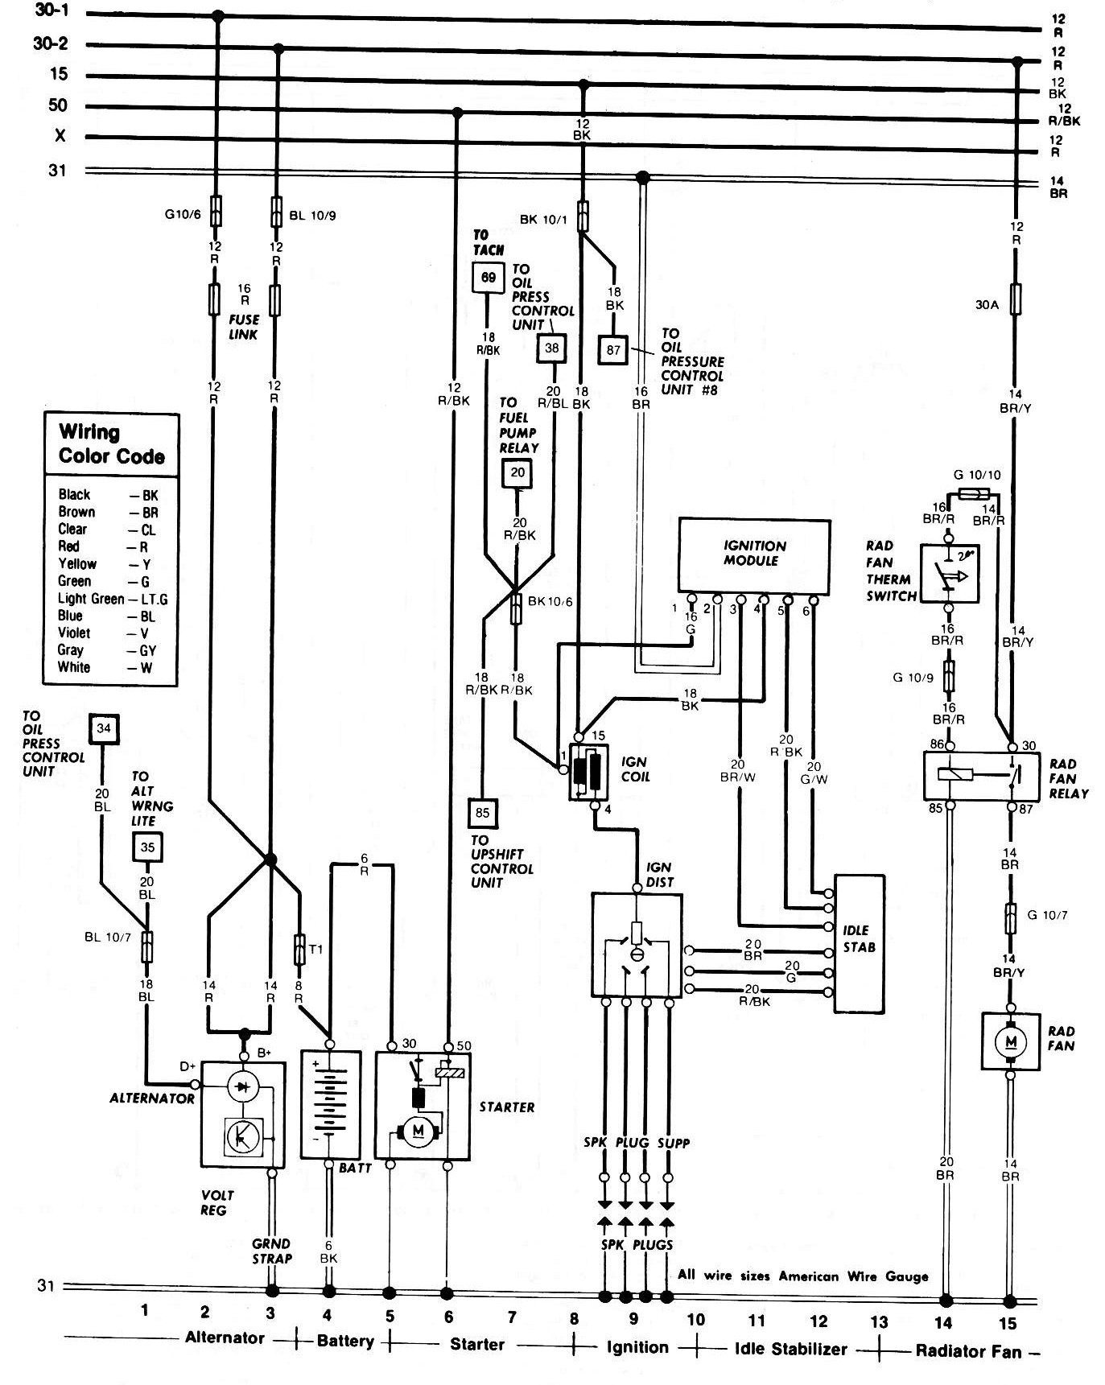

Slide 13
Two Content Layout with SmartArt

